Slide 1

Introduction to Artificial Neural Network and It’s Usage in DIP
CSE 4883: Digital Image Processing
Md. Tanvir Raihan
Slide Credit: Raiyan Rahman Sir

Slide 2

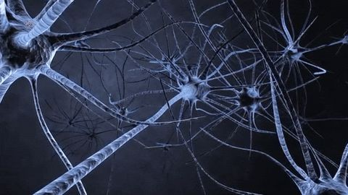
A Little Inspiration from Biology!
37

Slide 3
Outline
Learning
Forms of Learning
Supervised Learning
Artificial Neural Network
Activation Functions and Performance Metrics
Code!

Slide 4
What is “Learning” in AI?
An agent is learning if it improves its performance on future tasks after making observations about the world.
In which we describe agents that can improve their behavior through diligent study of their own experiences.

Slide 5
Forms of Learning
Any component of an agent can be improved by learning from data.
The improvements depend on four major factors:
✔ Which component is to be improved.
✔ What prior knowledge the agent already has.
✔ What representation is used for the data and the component.
✔ What feedback is available to learn from.
LecDReapiytaonf, CSE, MUIUST

Slide 6
Forms of Learning Based on Feedback
There are three types of feedback that determine the three main types of learning:
Unsupervised learning
✔ Agent learns patterns in the input even though no explicit feedback is supplied
✔ Clustering – concept of “good traffic days” and “bad traffic days”
Reinforcement learning
✔ Agent learns from a series of reinforcements—rewards or punishments
✔ Getting tips for taxi agent, winning point for chess game
Supervised learning
✔ Agent observes some example input–output pairsand learns a function that maps from input to output
✔ Semi-supervised learning - a few labeled examples and a large collection of unlabeled examples
LecDReapiytaonf, CSE, MUIUST

Slide 7
Supervised Learning
Training Set – a set of N example input–output pairs
Hypothesis – a possible function for generating output
Test Set – a set of examples that are distinct from the training set
Learning – a search through the space of possible hypotheses for one that will perform well
LecDReapiytaonf, CSE, MUIUST

Slide 8
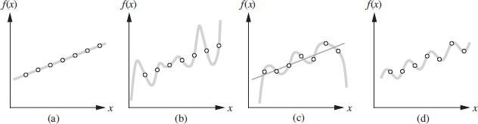
Supervised Learning
Hypothesis – a possible function for generating output
LecDReapiytaonf, CSE, MUIUST

Slide 9
Supervised Learning..
Classification – When the output y is one of a finite set of values (such as sunny, cloudy or rainy), the learning problem is called classification, and is called Boolean or binary classification if there are only two values.
Regression – When y is a number (such as tomorrow’s temperature), the learning problem is called regression.
LecDReapiytaonf, CSE, MUIUST

Slide 10
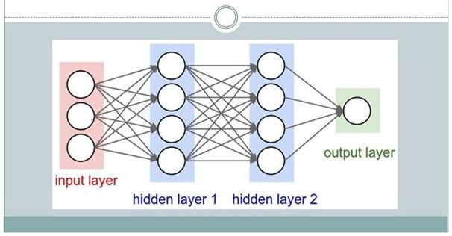
What is ANN?

Slide 11
What is ‘Artificial neural network’?
Artificial neural networks are one of the main tools used in machine learning.
As the “neural” part of their name suggests, they are brain-inspired systems that are intended to replicate the way that we humans learn.
Neural networks consist of input and output layers, as well as (in most cases) a hidden layer consisting of units that transform the input into something that the output layer can use. They are excellent tools for finding patterns that are far too complex or numerous for a human programmer to extract and teach the machine to recognize.

Slide 12
Artificial Neural Network
Input layer: Number of neurons in this layer corresponds to the number of inputs to the neuronal network.
Hidden layer: This layer has arbitrary number of layers with arbitrary number of neurons.
Output layer: The number of neurons in the output layer corresponds to the number of the output values of the neural network.

Slide 13
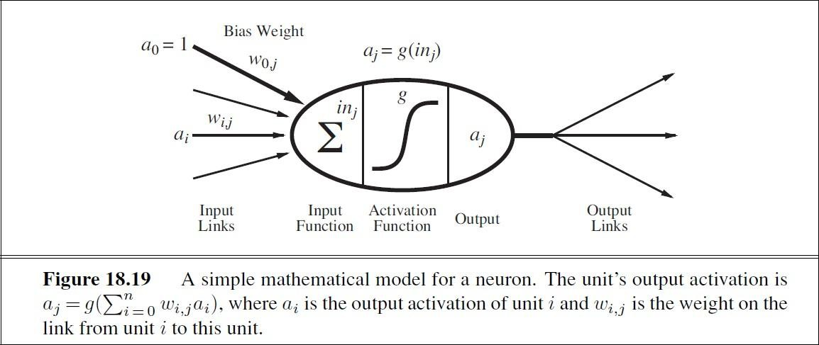
Artificial Neural Network
48

Slide 14
Artificial Neural Network
Units
Links
Weight
Activation
Activation function

Slide 15
Artificial Neural Network
x 1
x 2
wx+b
g(z)
a=𝑦
x 3

Slide 16
Artificial Neural Network
x1
W11
W21
x2
a1
W31
W13
x3
x1
a3
a=𝑦
W12
a2
W23
x2
W22
W32
x3

Slide 17
ANN - Activation Functions
tanh
Sigmoid
Relu
Leaky Relu
Softmax
Identity

Slide 18
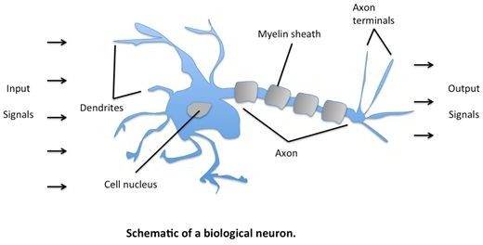
Basic Structure of ANN
The idea of ANNs is based on the belief that working of the human brain by making the right connections can be imitated using silicon and wires as living neurons and dendrites.

Slide 19
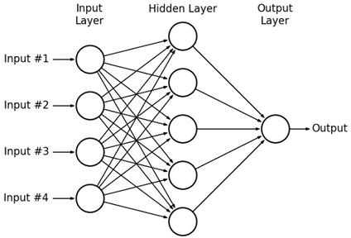
Basic Structure of ANN
ANNs are composed of multiple nodes, which imitate biological neurons of the human brain. The neurons are connected by links and they interact with each other. The nodes can take input data and perform simple operations on the data. The result of these operations is passed to other neurons. The output at each node is called its activation or node value.
Each link is associated with weight. ANNs are capable of learning, which takes place by altering weight values

Slide 20
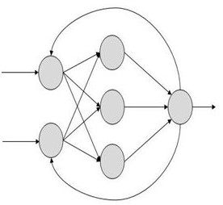
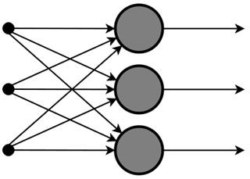
Types of Artificial Neural Networks
There are two Artificial Neural Network topologies − FeedForward and Feedback.

Slide 21
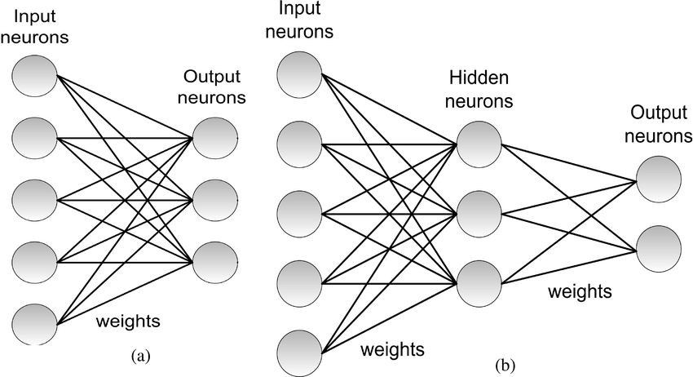
Types of Artificial Neural Networks
Considering the layer, there are two Artificial Neural Network topologies: A single-layer
perceptron and a multi-layer perceptron.
A single-layer perceptron is more suitable for simple and linear problems, while a multi-layer perceptron is more suitable for complex and non-linear problems.

Slide 22
Activation Functions and their Types
What is Activation Function?
It’s just a function that you use to get the output of the node. It is also known as Transfer Function.
Their main purpose is to convert an input signal of a node in an ANN to an output signal. That output signal now is used as an input in the next layer in the stack.
Specifically in A-NN we do the sum of products of inputs(X) and their corresponding Weights (W) and apply an Activation function f(x) to it to get the output of that layer and feed it as an input to the next layer.
It is used to determine the output of neural network like yes or no. It maps the resulting values in between 0 to 1 or -1 to 1 etc. (depending upon the function).
The Activation Functions can be based on 2 types-
Linear Activation Function
Non-linear Activation Functions

Slide 23
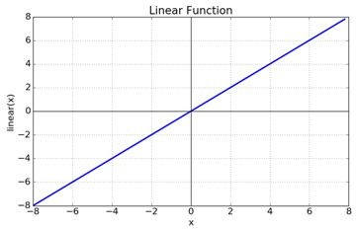
Linear Activation Functions
As you can see the function is a line or linear. Therefore, the output of the functions will not be confined between any range.
Equation: f(x) = x
Range: (-infinity to infinity)

Slide 24
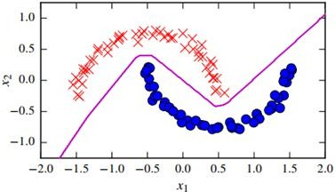
Non-linear Activation Functions
The Nonlinear Activation Functions are the most used activation functions.
Nonlinearity helps to makes the graph look something like this
It makes it easy for the model to generalize or adapt to a variety of data and to differentiate between the outputs.

Slide 25
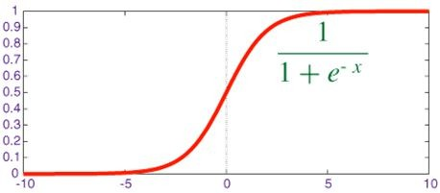
Different Types of Activation function in non-Linear
Sigmoid Activation Function
The main reason why we use the sigmoid function is that it exists between (0 to 1). Therefore, it is especially used for models where we have to predict the probability as an output. Since the probability of anything exists only between the range of 0 and 1, sigmoid is the right choice.

Slide 26
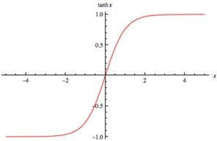
Different Types of Activation function in non-Linear
Tanh Activation Function
tanh is also like logistic sigmoid but better. The range of the tanh function is from (-1 to 1). tanh is also sigmoidal (s-shaped).
Both tanh and logistic sigmoid activation functions are used in feed-forward nets.

Slide 27
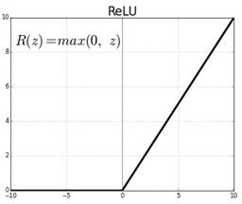
Different Types of Activation function in non-Linear
ReLU (Rectified Linear Unit) Activation Function
The ReLU is the most used activation function in the world right now. Since it is used in almost all the convolutional neural networks or deep learning.
As you can see, the ReLU is half rectified (from bottom). f(z) is zero when z is less than zero and f(z) is equal to z when z is above or equal to zero.
Range: [ 0 to infinity)

Slide 28
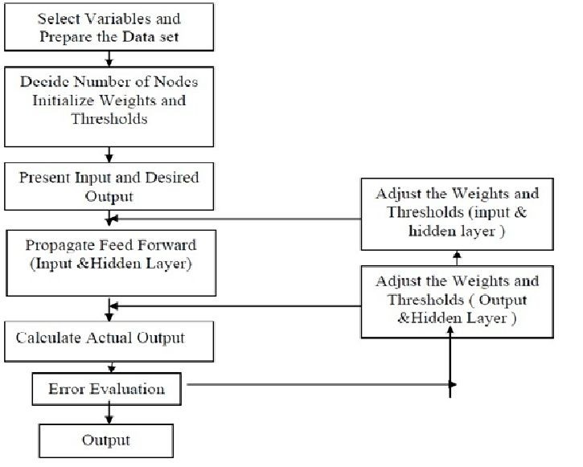
ANN Methodology

Slide 29
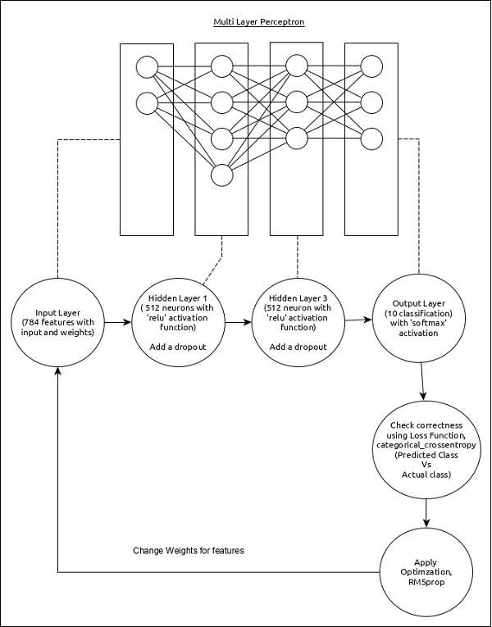

Slide 30
ANN Methodology
Step 1: Randomly initialize the Weights to a small number close to 0 (but not 0).
Step 2: Input the first observation of your dataset in the input layer, each feature in one input node.
Step 3: Forward-Propagation: from left to right, the neurons are activated in a way that the impact of each neuron’s activation is limited by the weights. Propagates the activations until getting the predicted result y.
Step 4: Compare the predicted result to the actual result. Measure the generated error.
Step 5: Back-Propagation: from left to right, the error is back-Propagated. Update the weights according to how much they are responsible for the error. The Learning rate decides how much we update the weights.
Step 6: Repeat step 1 to step 5 and updates the weights after each observation.
Step 7: When the whole training set passed through the ANN that makes an epoch.
Redo more epoch.
65
Lec Raiyan, CSE, UIU

Slide 31
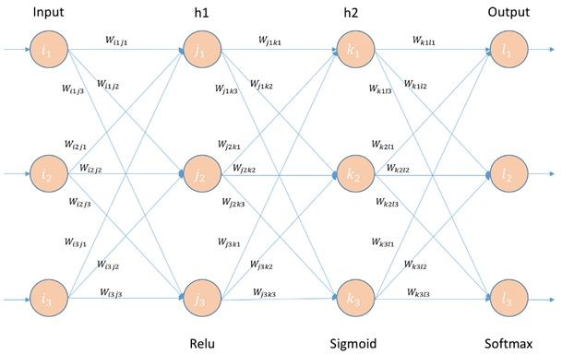
ANN Architecture

Slide 32
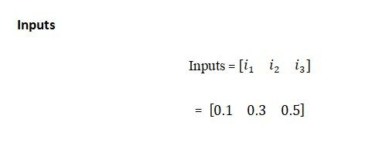
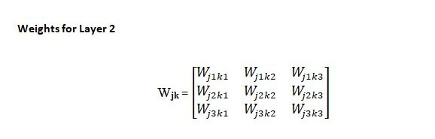
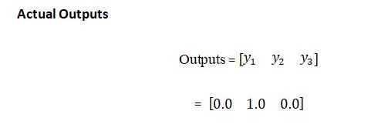
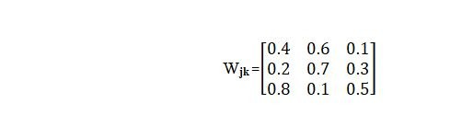
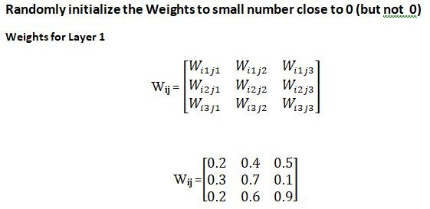
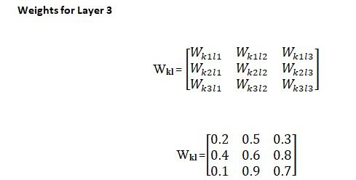
ANN Architecture

Slide 33
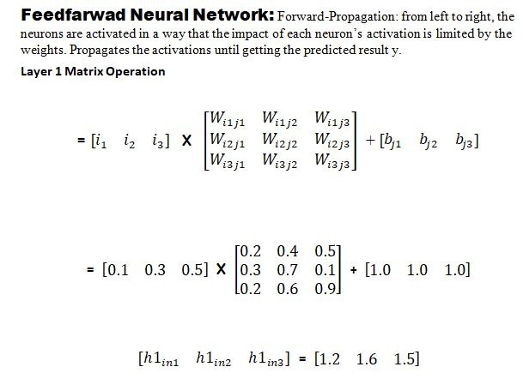
ANN Architecture

Slide 34
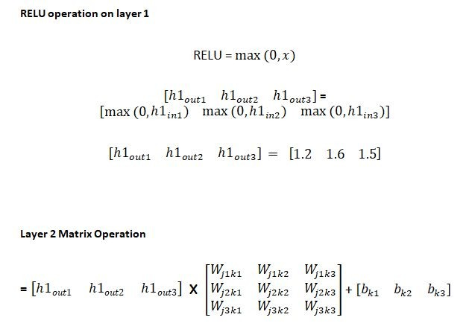
ANN Architecture

Slide 35
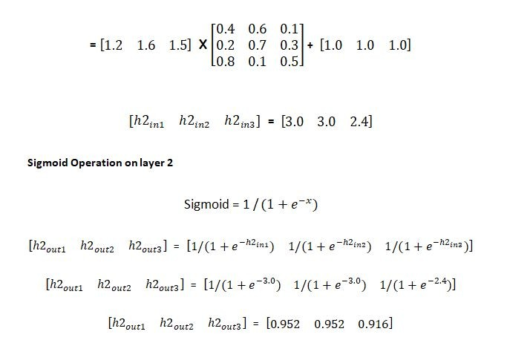
ANN Architecture

Slide 36
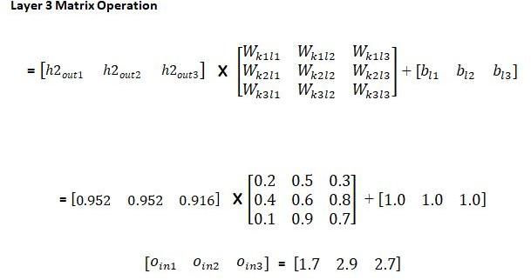
ANN Architecture

Slide 37
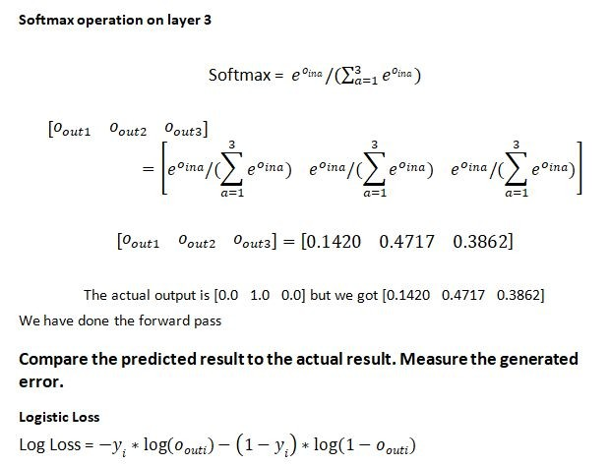
ANN Architecture

Slide 38
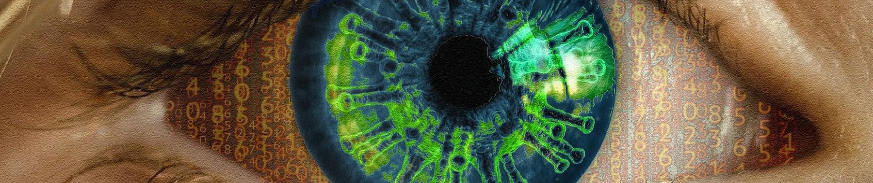
Practical Implementation of Artificial Neural Network
Cataract Detection
Kaggle Notebook

Slide 39
Practical Implementation of Artificial Neural Network
In this part, you will be solving a data analytics challenge for a bank. You will be given a dataset with a large sample of the bank’s customers. To make this dataset, the bank gathered information such as customer id, credit score, gender, age, tenure, balance, if the customer is active, has a credit card, etc. During 6 months, the bank observed if these customers left or stayed in the bank.
Your goal is to make an Artificial Neural Network that can predict, based on geo-demographical and transactional information given above, if any individual customer will leave the bank or stay (customer churn). Besides, you are asked to rank all the customers of the bank, based on their probability of leaving. To do that, you will need to use the right Deep Learning model, one that is based on a probabilistic approach.
If you succeed in this project, you will create significant added value to the bank. By applying your Deep Learning model the bank may significantly reduce customer churn.

Slide 40
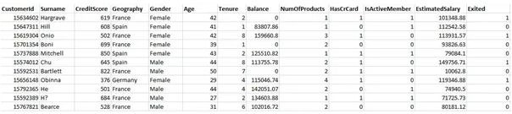
Dataset Sample

Slide 41
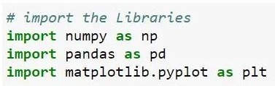
Data Preprocessing
Import the Libraries
In this step, we import three Libraries in Data Preprocessing part. A library is a tool that you can use to make a specific job. First of all, we import the numpy library used for multidimensional array then import the pandas library used to import the dataset and in last we import matplotlib library used for plotting the graph.

Slide 42
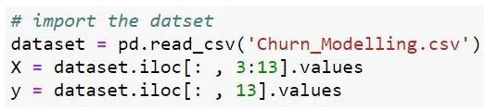
Data Preprocessing
Import the dataset
In this step, we import the dataset to do that we use the pandas library. After import our dataset we define our dependent and independent variable. Our independent variables are 1 to 12 attributes as you can see in the sample dataset which we call ‘X’ and dependent is our last attribute which we call ‘y’ here.

Slide 43
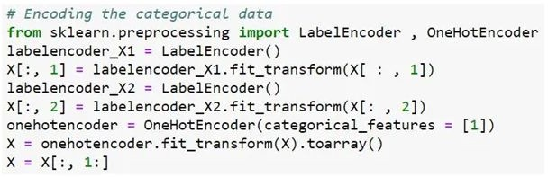
Data Preprocessing
Encoding the Categorical data
In this step, we Encode our categorical data. If we see our dataset then Geography & Gender attribute is in Text and we Encode these two attributes in this part use the LabelEncoder and OneHOTEncoder from the Sklearn.processing library.

Slide 44

Data Preprocessing
Split the dataset for test and train
In this step, we split our dataset into a test set and train set and an 80% dataset split for training and the remaining 20% for tests. Our dataset contains 10000 instances so 8000 data we train and 2000 for the test.

Slide 45
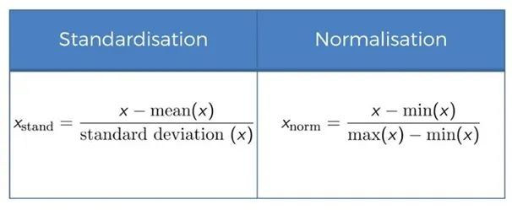
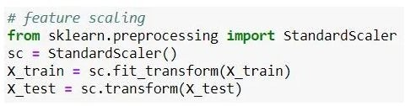
Data Preprocessing
Feature Scaling
Feature Scaling is the most important part of data preprocessing. If we see our dataset then some attribute contains information in Numeric value some value very high and some are very low if we see the age and estimated salary. This will cause some issues in our machine learning model. To solve that problem, we set all values on the same scale. There are two methods to solve that problem, first one is Normalize and Second is Standard Scaler.
Here we use standard Scaler import from Sklearn Library.

Slide 46

Building our Model
Import the Libraries
In this step, we import the Library which will build our ANN model. We import Keras Library which will build a deep neural network based on Tensorflow because we use Tensorflow backhand. Here we import the two modules from Keras. The first one is Sequential used for initializing our ANN model and the second is Dense used for adding different layers of ANN.

Slide 47

Building our Model
Initialize our ANN model
In this step, we initialize our Artificial Neural Network model to do that we use sequential modules.
Most of the ANN also has layers in sequential order and the data flows from one layer to another layer in the given order until the data finally reaches the output layer.

Slide 48

Building our Model
Adding the input layer and first hidden layer
In this step, we use the Dense model to add a different layer.
The parameter which we pass here first is units=6 which defines hidden layer=6
The third parameter is activation= ‘relu’ here in the first hidden layer we use relu activation.
And the last parameter which we pass in dense function is input_dim= 11 which means the input node of our Neural Network is 11 because our dataset has 11 attributes that’s why we choose 11 input nodes.

Slide 49


Building our Model
Adding the second hidden layer
In this step, we add another hidden layer
Adding the output layer
In this step, we add an output layer in our ANN structure units = 1 which means one output node here we use the sigmoid function because our target attribute has a binary class which is one or zero that’s why we use sigmoid activation function.

Slide 50
Building our Model
Optimizer
Optimizers are algorithms or methods used to change the attributes of your neural network such as weights and learning rate by comparing the prediction and the loss function, in order to reduce the losses. How you should change your weights or learning rates of your neural network to reduce the losses is defined by the optimizers you use.
Keras provides quite a few optimizer as a module, optimizers and they are as follows:
SGD,
Adagrad,
Adadelta,
Adam,
Adamax,
Nadam

Slide 51
Building our Model
Metrics
In machine learning, Metrics is used to evaluate the performance of your model. It is similar to loss function, Keras provides quite a few metrics as a module, metrics and they are as follows
accuracy, F1 Score
binary_accuracy
categorical_accuracy
sparse_categorical_accuracy
top_k_categorical_accuracy
sparse_top_k_categorical_accuracy
cosine_proximity
clone_metric
Similar to loss function, metrics also accepts below two arguments −
y_true − true labels as tensors
y_pred − prediction with same shape as y_true
86□

Slide 52
Building our Model
Compile the model
Keras model provides a method, compile() to compile the model. The argument and default value of the compile() method is as follows
The important arguments are as follows −
loss function
Optimizer
metrics

Slide 53
Building our Model
Compile the model
In this step, we compile the ANN.
Here, the first parameter is optimizer = ‘Adam’. Here, Adam is very efficient one, so that’s why we use Adam optimizer here.
The second parameter is loss this corresponds to loss function. Here we use binary_crossentropy because if we see target attribute our dataset which contains the binary value that’s why we choose the binary cross-entropy.
The final parameter is metrics basically It’s a list of metrics to be evaluated by the model and here we choose the accuracy metrics.

Slide 54
Building our Model
Model Training
Models are trained by NumPy arrays using fit(). The main purpose of this fit function is used to evaluate your model on training. This can be also used for graphing model performance. It has the following syntax −
model.fit(X, y, epochs = , batch_size = )
At the end of the batch, the predictions are compared to the expected output variables and an error is calculated. From this error, the update algorithm is used to improve the model, e.g. move down along the error gradient.
Batch Gradient Descent. Batch Size = Size of Training Set
Stochastic Gradient Descent. Batch Size = 1
Mini-Batch Gradient Descent. 1 < Batch Size < Size of Training Set

Slide 55
Building our Model
Model Training
model.fit(X, y, epochs = , batch_size = )
A One epoch means that each sample in the training dataset has had an opportunity to update the internal model parameters. An epoch is comprised of one or more batches. For example, as above, an epoch that has one batch is called the batch gradient descent learning algorithm.
You can think of a for-loop over the number of epochs where each loop proceeds over the training dataset. Within this for-loop is another nested for-loop that iterates over each batch of samples, where one batch has the specified “batch size” number of samples.
The number of epochs is traditionally large, often hundreds or thousands, allowing the learning algorithm to run until the error from the model has been sufficiently minimized. You may see examples of the number of epochs in the literature and in tutorials set to 10, 100, 500, 1000, and larger.

Slide 56

Building our Model
Model Training
In this step we fit the training data in our model. X_train, y_train is our training data.
Here a batch size is basically a number of observations after which you want to update the weights here we take batch size 10.
And the final parameter is epoch is basically when whole the training set passed through the ANN here we choose the 100 number of the epoch.

Slide 57
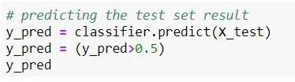
Making the Prediction and Accuracy Result
Predict the test set Result
In this step, we predict our test set result here our prediction results in probability so we choose 1(customer leave the bank) if the probability is greater than 0.5 otherwise 0(customer don’t leave the bank).

Slide 58
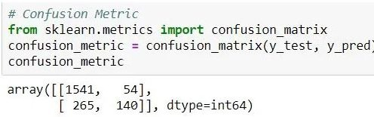
Making the Prediction and Accuracy Result
Confusion matrix
In this step we make a confusion matrix of our test set result to do that we import confusion matrix from sklearn.metrics then in confusion matrix, we pass two parameters first is y_test which is the actual test set result and second is y_pred which predicted the result.

Slide 59
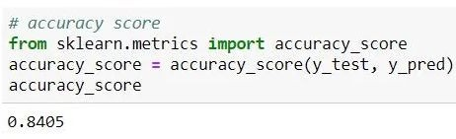
Making the Prediction and Accuracy Result
Accuracy Score
In this step, we calculate the accuracy score based on the actual test result and predict test results.
So here we go we get 84.05% of our ANN model.

